Slide 1
Data science : Project
Alcool consomption of students
Group S :
Axel BELLOC
Raphael DERVIEUX
Matheo DUGUE

Slide 2
SUMMARY :
WHY
OBJECTIVES
HYPOTHESES
HOW
INITIAL RESULT

Slide 3
Why was this topic chosen :
We chose this topic because there are several interesting points that make us want to study this topic, such as:
Public health: Excessive alcohol consumption can have serious consequences for the physical and mental health of individuals. By studying alcohol consumption among students, we can identify the trends, risks and associated health problems.
Prevention of abuse: Understanding students' drinking habits helps develop more effective prevention strategies to reduce the risk of alcohol abuse, addiction and risky behaviors.
Risk behaviors: Alcohol consumption may be associated with risk behaviors such as drunk driving, sexual assault, accidents, etc. Studying these links allows for targeted awareness and intervention programs.
Impact on studies: Excessive alcohol consumption can have a negative impact on students' academic success by disrupting their concentration, memory and overall performance. By understanding these links, educational institutions can develop support initiatives.
Institutional Response: Universities and colleges can use student alcohol consumption data to adapt their mental health and wellness policies and resources. This may include outreach programs, counselling services, and resources to help students manage the stresses and pressures associated with academic life.
Sociological research: The study of student alcohol consumption can also provide important information on social trends, cultural influences and factors that contribute to alcohol-related behaviors in this specific population.

Slide 4
Objectives :
The objective of this project is to make an analysis of the data and to document it in order to bring the most convincing results regarding the consumption of alcohol among the students. Through this analysis and this work, we could help the University of Vic or our university (ESILV) in the help and follow-up of students with alcohol problems.
So with our project we will try to find several important factors that promote alcohol consumption, in order to make it easier to make predictions that will make it easier to find students in need.

Slide 5
Hypothesis :
Here are some hypotheses that we have developed for the moment, in the rest of the project we may change, withdraw or add assumptions.
Hypotheses :
There is a correlation between grades and alcohol consumption
Men drink more alcohol than women
There is a correlation between bad relationships with parents and alcohol consumption
Students who study a little will drink much more alcohol
Students with not much money consume more alcohol
Students who often go out with friends drink more
Students with many absences drink a lot

Slide 6
How :
In this project, we are gonna study each hypothesis in 3 main steps :
Reflection : we will reflect on the hypothesis, make changes or clarifications
Using the dataset: We will use the dataset retrieved on Kaggle to provide details on the hypothesis, to modify or demonstrate the hypothesis
Use scientific documentation online to compare our results, which allows us to better develop our results or to show that our results are not correct (primarily with pubmed)

Slide 7
Initial results :
1. There is a correlation between grades and alcohol consumption
2. Men drink more alcohol than women

Slide 8
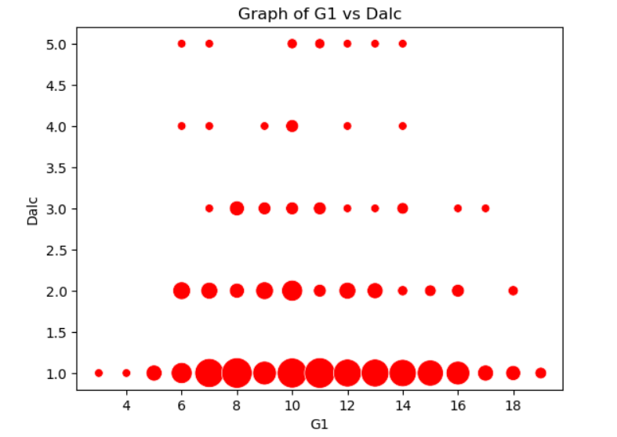
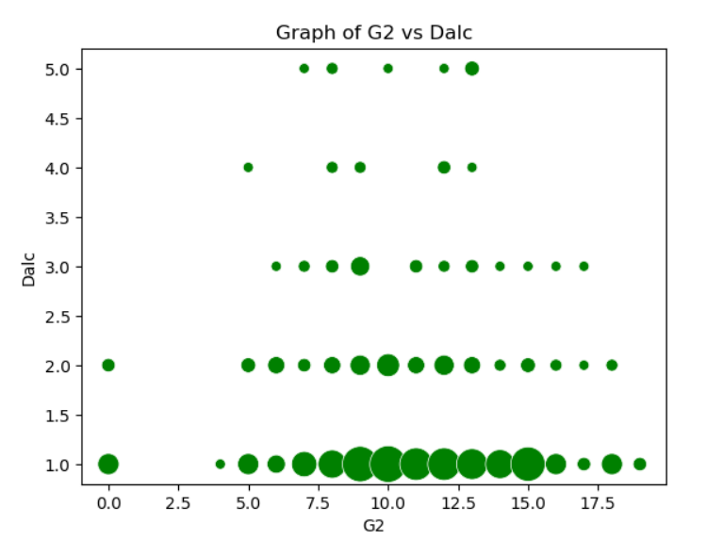
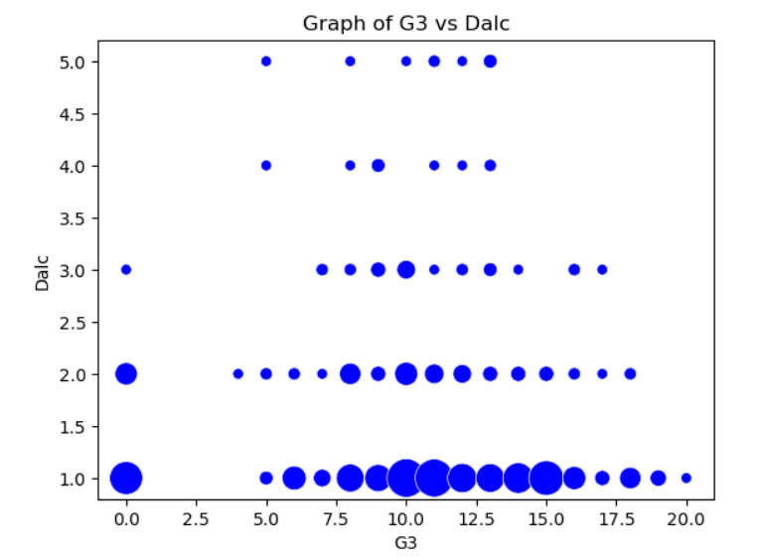
1. Study of the workday consumption of alcohol and correlation with grades :
Data from the dataset « student_alcohol_data » :
Average grades for students with a very low workday alcohol consumption
G1 : 11.155797101449275
G2 : 10.94927536231884
G3 : 10.731884057971014
Average grades for students with a low workday alcohol consumption
G1 : 10.306666666666667
G2 : 10.013333333333334
G3 : 9.253333333333334
Average grades for students with an average workday alcohol consumption
G1 : 10.576923076923077
G2 : 10.538461538461538
G3 : 10.5
Average grades for students with a high workday alcohol consumption
G1 : 9.777777777777779
G2 : 9.777777777777779
G3 : 9.88888888888889
Average grades for students with a very high workday alcohol consumption
G1 : 10.444444444444445
G2 : 10.777777777777779
G3 : 10.666666666666666
We can see that the group with a very low workday alcohol consumption have better average grades
than the other groups We can study if the consumption of alcohol is higher for the people with lower grades
We can see in the graph that that for every grades, the students with a high and very high workday consumption
of alcohol have grades between 5 and 15, but for students with a very low workday consumption of alcohol the grades
are between 0 and 20
In resume, i can say that maybe grades are not an important factor with the workday consumption of alcohol of students
(For the moment, it is only a brief study)

Slide 9
1. Study of the workday consumption of alcohol and correlation with grades :
Documentation link :
Investigating the Role of Alcohol in Behavioural Problems at School among Secondary School Students in Barbados - PubMed (nih.gov)
This study examines the role of alcohol consumption in student behaviour problems at school, focusing on the situation in Barbados, where the prevalence of alcohol consumption is high. Data were extracted from the National Secondary School Survey and analyzed using statistical methods such as binary logistic regression.
The results of the bivariate analysis indicate significant associations between behavioural problems at school and factors such as age, class, sense of belonging at school, the relationship with teachers and alcohol use in the past month. However, multivariate analysis reveals that alcohol consumption in the past year or last month is not significantly associated with frequent behavioral problems in school.
In conclusion, this study does not find a significant link between student alcohol consumption and common behavioral problems at school. On the other hand, significant inverse associations are observed with the age of students (the youngest being less likely) and the quality of the relationship with teachers (a not very bad relationship is associated with a significant reduction in behavioural problems). Thus, the study suggests that factors other than alcohol consumption, such as age and relationship with teachers, may have a greater impact on student behaviour at school than alcohol consumption.

Slide 10
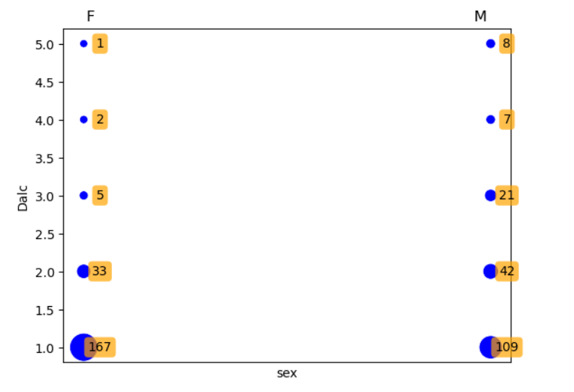
2. Men drink more than women
There are 208 female students and 187 male students.
This makes a distribution of 47% and 53% around, so the distribution between the two sex seems to be fair.
We can see that there are slightly more women than men on the total
figure, and yet in the graph we can see that there are more men who
drink a lot than women who drink a lot, and conversely there are more
women who drink little than men who drink little.
So in summary, we can make a first confirmation of this theory
thanks to a first analysis of the data

Slide 11
2. Men drink more than women
Documentation link :
Investigating the Role of Alcohol in Behavioural Problems at School among Secondary School Students in Barbados - PubMed (nih.gov)
This document focuses on alcohol consumption among Romanian students and its correlations with other lifestyle factors. The following is some information useful to prove the hypothese that men drink more than woman :
The aim of the study was to assess the alcohol consumption of Romanian students and correlate it with other lifestyle factors. The cross-sectional study involved 1212 university students, with an average age of 21.1 2.4 years. The results indicate a high prevalence of alcohol consumption among the student population studied, reaching 79.9%.
Multiple regression analyses revealed several significant associations with alcohol consumption, including gender: Alcohol consumption was positively associated with the male gender.
So using this documentation and the data from the previous slide, it further confirms the assumption.

